Slide 1


Special Educational Needs and Disabilities
Information Report
2025-2026

Slide 2

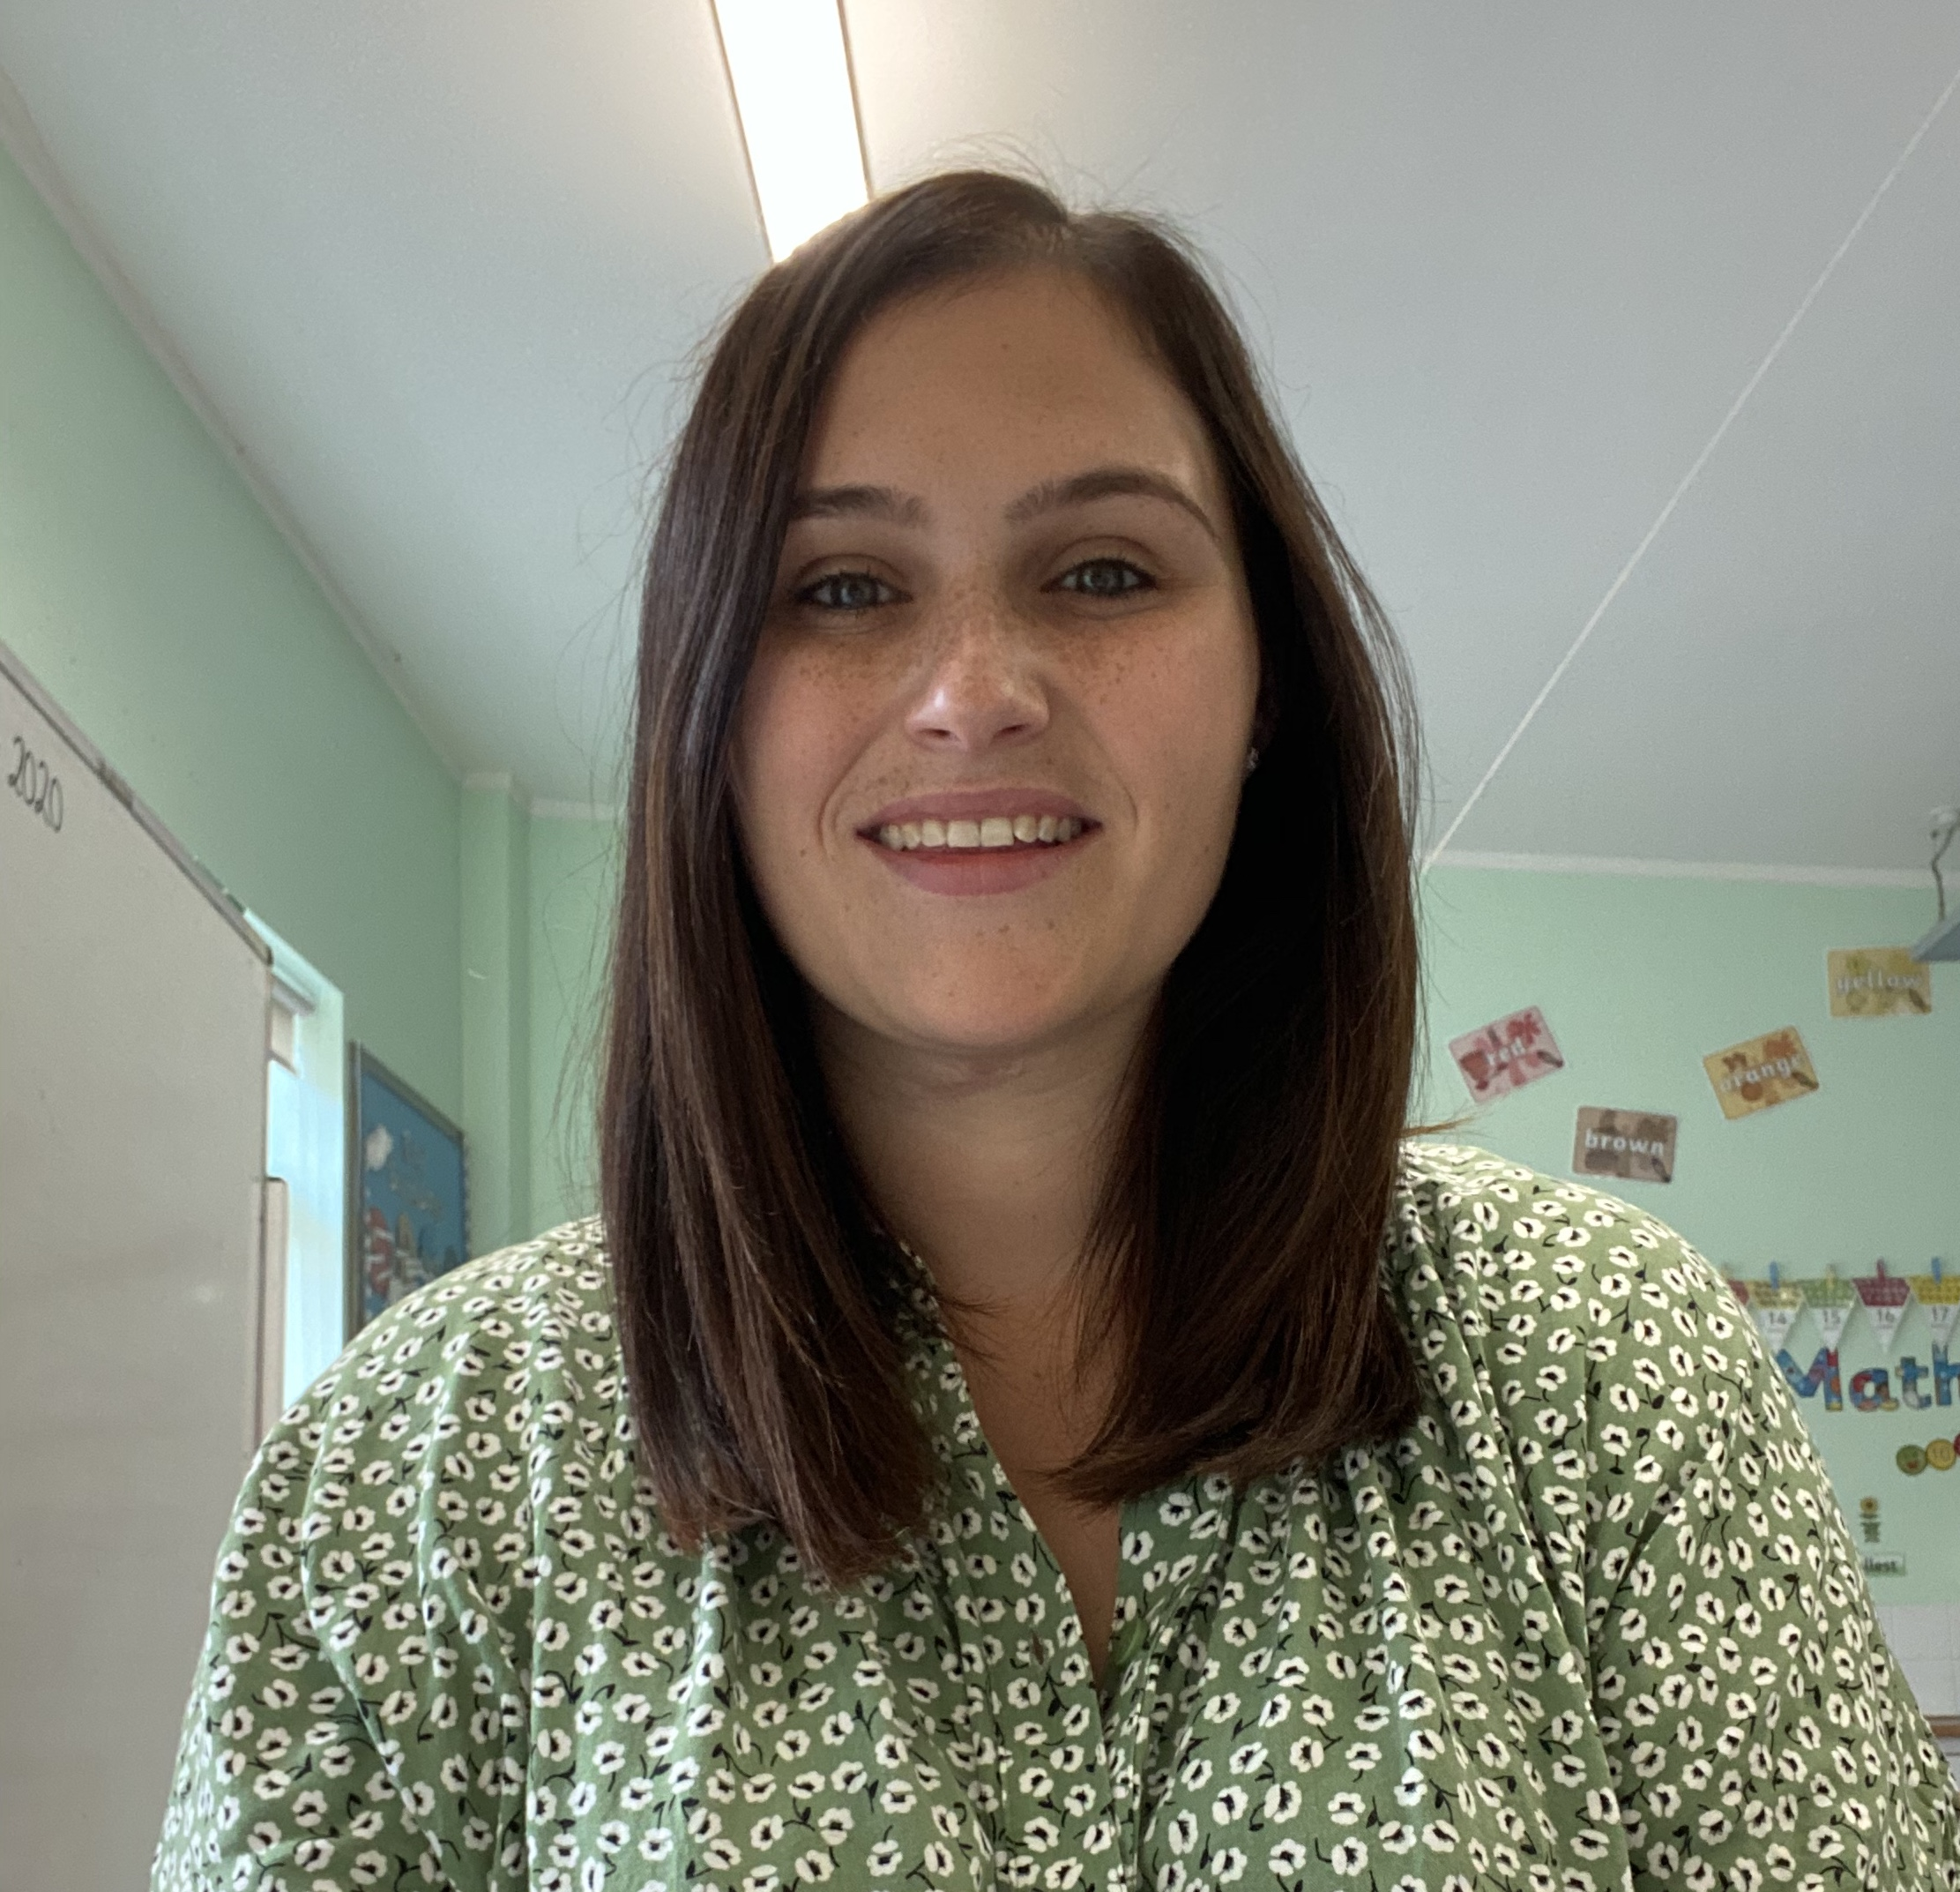
Hello and Welcome
Hello, I’m Mrs. Ball, the SENDCo, Designated Teacher for Children Looked After, and Deputy Safeguarding Lead.
This document aims to explain how we support children with Special Educational Needs and their families.
If you have any questions about your child’s progress or well-being, please contact your child’s teacher, a member of the Senior Leadership Team, or myself directly.

Slide 3

Our Inclusion Statement
‘St John Rigby is committed to providing an appropriate and high-quality education to all the children in our care. We believe that all children, including those identified as having special educational needs and disabilities, have a common entitlement to a broad and balanced academic and social curriculum, which is accessible to them, and are to be fully included in all aspects of school life.’

Slide 4




What types of SEND do we provide for?
At St John Rigby we have children with SEN in all of the four broad ‘areas of need’ as named in the SEND Code of Practice 2014.
Communication and Interaction
Cognition and Learning
Sensory and/or Physical Needs
Social, Emotional and Mental Health

Slide 5

How do we identify SEND and assess needs?
A child with SEND will be identified by either one of these three ways:
If a teacher has a concern, they will discuss it with parents and monitor progress using the Assess–Plan–Do–Review cycle. After six weeks, the process is reviewed with the SENDCo, who may conduct further assessments or involve external agencies if needed.
Through assessments and tracking progress.
A parent may tell us that you think your child may be struggling with something, so we will investigate and monitor progress using the Assess–Plan–Do–Review cycle.
Parents are kept informed and involved throughout. The teacher and SENDCo guide the process following the Graduated Response outlined in the SEND Code of Practice, creating a personalised Learning Plan if a SEND need is identified.

Slide 6

What is our approach to teaching children with SEND?
Your child’s class teacher will…
Monitor progress.
Offer an inclusive, flexible curriculum that values every child and supports diverse learning needs.
Staff adapt teaching and provision to remove barriers and ensure all pupils can access and succeed in every aspect of school life.
Communicate regularly with you about your child’s progress and create and implement their Learning Plan.

Slide 7

What is our approach to teaching children with SEND?
Mrs. Ball (SENDCo) and the Inclusion Team coordinate all SEND provision, ensuring effective support for children with additional needs.
We will work closely with staff, parents, and external agencies, maintain the SEND register, and keep detailed records of each child’s progress.
We will oversee the school’s SEND policy, advise on resources and support strategies, manage transitions, and ensure reasonable adjustments and access arrangements are in place.

Slide 8

How do we adapt the curriculum and environment for pupils with SEND?
At St John Rigby, we offer an inclusive, flexible curriculum that values every child and supports diverse learning needs. Staff adapt teaching and provision to remove barriers and ensure all pupils can access and succeed in every aspect of school life.

Slide 9

What different teaching approaches do we have for pupils with SEND?
Quality First Teaching
Specific Individual and Group Work Intervention
Specialist Professional Involvement
Specified Individual Support- Education, Health and Care Plan (EHCP)

Slide 10

Quality First Teaching
Teachers have the highest possible expectations for your child and all pupils in their class.
Your child is fully involved in learning in class and strategies suggested by the SENCO, or other professionals working with your child, are in place to support your child to learn.
The learning environment is carefully considered to meet the needs of all learners.
Your child’s voice is heard through their pupil passport.

Slide 11

Specific Individual and Group Work Intervention
This would be a program focused on a specific area of learning and could be run by a teacher or a Learning Mentor.
An example of interventions available St John Rigby include:
Memory Games | Letter Join | Phonics: Keep Up Catch Up | Reading Comprehension | Zones of Regulation | Dictation
Tap Tap Box | Times Tables | Precision Teaching | Fine Motor Skills | Social Stories | Sentence Semantics
Sensory Circuits | Maths Fluency | Daily Reading | Pencil Control | Blacks Questioning | Speech Sounds for Speech and Language
Learning Village | Number | Reading Fluency | Buddies | Nuffield Early Language Intervention (NELI) | Drawing and Talking

Slide 12

Specialist Professional Involvement
You may be asked to give permission for your child to be referred to a specialist professional. This will help you and the school to understand your child’s needs better and so support them more effectively.
Some of the Specialist Professional Involvement that we can access at St John Rigby include:
Child Development Centre NHS | Community Health Clinics (Paediatrician NHS) | School Nursing Team NHS | CHUMS | Social Care | Early Years Support Team | Occupational Therapy Team NHS | Visual Impairment Team NHS
Physiotherapy Team NHS | Speech and Language Therapy NHS | Continence Team NHS | CAMHS NHS | Educational Psychology Service | Autism Spectrum Advisory Teachers | Hearing Impairment Team NHS | SEND Outreach Team

Slide 13

Specified Individual Support- Education, Health and Care Plan (EHCP)
This support is for children with severe, complex, and long-term needs.
An EHCP sets out expected outcomes, strategies, and goals, providing flexible support through funding bands rather than fixed hours.
Support may include staff, equipment, or external specialists.
Each EHCP is reviewed annually with the child, parents, staff, and relevant professionals.

Slide 14

How do we assess and review the progress of SEND learners?
Each child on the SEND register has a Learning Plan. These are reviewed termly using Assess, Plan, Do, Review process:
Assess: Gather information from parents, the child, teachers, and assessments to understand needs.
Review: Evaluate the impact of support with input from the learner, parents, staff, and agencies, then adjust plans for the next cycle.
Plan: Identify learning barriers, set outcomes, and outline support in a Learning Plan, which is reviewed regularly.
Do: Deliver the planned support and additional help for learning.

Slide 15

How can parents support their child?
Attending Parent’s Evening twice a year | Attending and contributing to your child’s Learning Plan review 3 times per year | Attending Coffee Mornings run by the Inclusion Team | Attend Information Evenings for parents | If your child has an EHCP- attend the Annual Review
Reading stories to your child daily | Accessing homework tasks | Hearing your child read daily | Attend multi agency meetings | Read and engage with your child’s termly report
Working together is the best way to ensure that young people are happy and make progress. We encourage a close relationship between school and parents and our door is always open.

Slide 16

How do we ensure each child’s voice is heard for SEND?
At St John Rigby, we value clear communication and encourage every child to share their views and take an active role in their learning. We collect pupil voice through:
Frequent check-ins and one to one chats with the SENDCo.
Learning Plans and Individual Pupil Passports.
If your child has an EHCP their opinions will contribute to the Annual Review.
Shout Out To SEND events attended by all pupils with SEND.

Slide 17

How do we include all children beyond lessons?
Breakfast and After School Clubs
Extra Curricular Clubs
School Trips

Slide 18
How do we ensure staff have the expertise to support children with SEND?
The Inclusion Team meets fortnightly to work together to support all children and promote inclusion throughout the school. The Inclusion Team is formed of Mrs Ward (Inclusion Lead), Mrs McGettigan (Head Teacher) and Mrs McLoughlin (Family Support Worker).
A dedicated team of Teaching Staff and Learning Mentors support pupils across the school. Staff access professional development throughout the year from a range of external professionals. Examples of recent training for staff include:
Safeguarding | Lift Off To Language | Nuffield Early Language Programme | Makaton | Attention Autism | Understanding Dyslexia | TEACCH Tasks | Blanks Questioning
Sail Into Sounds | Mental First Aid | Cognitive Skills | Autism Education Framework | Anti-Bullying | Little Wandle Phonics | Adaptive Teaching | Transition Support

Slide 19

How does the school support children who are looked after by the Local Authority?
Mrs Ball works under the direction of Bedford’s Virtual Schools. We engage with the Personal Education Plan (PEP) so as to create a shared understanding across all settings.
Outside of school, Mrs Ball is a foster carer so has a significant amount of training and knowledge to support both children who are looked after and their carers.

Slide 20

How will school support my child in a transfer between phases of education?
When joining St John Rigby:
We gather information from previous settings, arrange any necessary support, offer school tours and meetings with the SENDCO, and can organise transition visits. Each new pupil is also paired with a buddy for their first week.
When moving on:
We contact the new school’s SENDCO, share relevant information, and transfer records promptly.
From KS2 to KS3:
We support families with applications and visits, and ensure teachers and the SENDCO meet with the secondary school to share key details.

Slide 21

How do we ensure our school is accessible for all?
At St John Rigby, we are committed to inclusion for all. Our facilities are fully accessible, with ramps, lifts, disabled toilets, and wide doorways throughout the school. Classrooms are designed for good acoustics, and calm lunchtime spaces support pupils who need quieter environments.
We use visual aids, adaptive technology, and flexible groupings to make learning accessible for every child. Parents and pupils are encouraged to share ideas to help us continue improving our inclusive practice.

Slide 22

How do we offer emotional support?
We are an inclusive school that celebrates diversity and promotes high self-esteem and well-being for all pupils. Inclusion is reflected in our teaching, training, RE & PSHE curriculum. Class teachers are the first point of contact for parents and work with the Senior Leadership and Inclusion Teams to provide tailored support.
We also collaborate with external agencies such as Health and Social Care, CAMHS, and specialist services to meet individual needs. Additional wellbeing programmes include Social Skills, Nurture, Buddies, and Drawing & Talking groups.

Slide 23

How do we prevent bullying?
At our primary school, we are committed to creating a safe, caring, and respectful environment where every child feels valued and included. Bullying of any kind is not tolerated, and we take proactive steps to prevent it through education, awareness, and clear procedures. Our Anti-Bullying Policy outlines how incidents are identified, reported, and addressed promptly, ensuring that all pupils know who to talk to if they need help. Throughout the year, we also take part in Anti-Bullying Week, which provides an important opportunity for pupils to learn about kindness, empathy, and respect through assemblies, classroom discussions, and creative activities. By promoting positive behaviour and open communication, we aim to empower children to stand up against bullying and support one another as part of a caring school community.

Slide 24

Further Information
At St John Rigby, children’s well-being and safety come first. We promote positive behaviour through clear policies, open communication, and early support, using Class Dojo to keep parents informed. Expectations of respect and kindness are reinforced throughout the year.

Slide 25

Complaints
At St John Rigby we try to deal with your concerns and complaints as quickly and smoothly as possible.
You can raise a concern in a variety of ways:
Speak to the class teacher on the door to make an appointment to raise your initial concern
Make an appointment through approaching or calling the Reception (01234 401900)
E-mail the school office Office@sjr.beds.olicatschools.org
Concerns will be dealt with under the terms of our Complaints Policy.
Bedford Borough can offer you impartial advice. E-mail them on Sendiass@bedford.gov.uk.

Slide 26


Further Support Services
Bedford Borough’s “Local Offer”
https://localoffer.bedford.gov.uk/kb5/bedford/directory/home.page
Bedford Borough Parent Carer Forum
https://www.bbpcf.co.uk/
Autism Bedfordshire
https://www.autismbedfordshire.net/
Faces
https://www.facesbedford.org/
NHS Speech and Language
https://bedslutonchildrenshealth.nhs.uk/services/bedfordshire-and-luton-childrens-speech-and-language-therapy-service/

Slide 27

Contact Details
Name of School | St John Rigby Catholic Primary School
Type of setting | Primary School 4-11
Name of SENDCO | Hannah Ball
Address | Polhill Avenue Bedford, MK41 9DQ
Phone Number of SENDCO | 01234 401900
Email of SENCo | hball@sjr.beds.olcatschools.org
Website | https://www.stjohnrigby.org/

